Slide 1

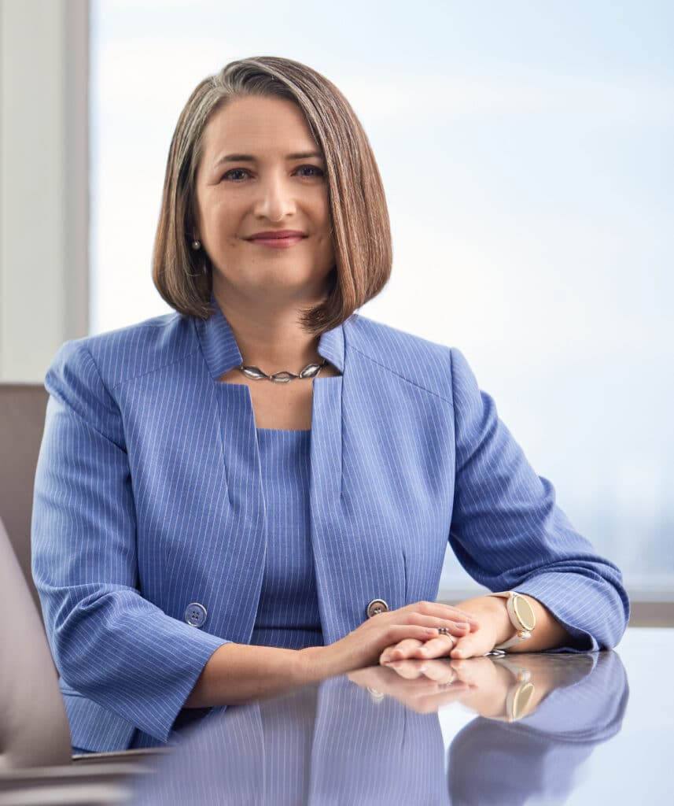


Upcoming Events
Hybrid January Lunch & Learn!
TRANSPORTATION &
DEVELOPMENT
INSTITUTE
Thursday, January 29, 2026
12:00 PM to 1:00 PM
Location:
BGE
10777 Westheimer Rd
Houston, Texas 77042
Houston Chapter
In-Person Cost with Lunch:
$20 ASCE member, $25 non-member
Virtual Cost:
$5 ASCE member, $10 non-member
Hosted by
“Formation and Function of
MUDs and Special Purpose Districts”
Presented by Alia Vinson
Questions?
e-mail tdi@ascehouston.org

